Slide 1
RETURNING FROM COVID19
“DOING GLIDING DIFFERENTLY”
Health and Safety

Slide 2
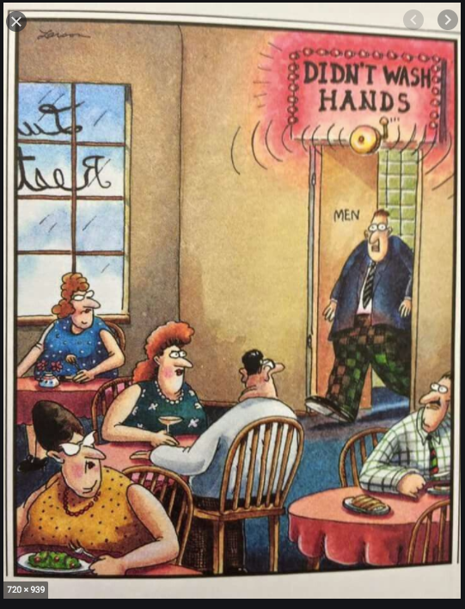
Copyright: The Far Side Gary Larsen

Slide 3
CHALLENGES – HEALTH & Safety
What do we need to consider?
Older members are more susceptible to the virus
What is your membership demographic?
Community transmission
What are your hygienic measures going forward?
What cleaning regimes have you planned?
1.5 metre social distancing rule – this may remain for some time
How will that affect your operations?
Notes:
PEOPLE ADAPT VERY QUICKLY TO SITUATIONS.
8 WEEKS IN AND WE ARE ALL ADAPTING TO A NEW REGIME OF SOCIAL DISTANCING, WASHING HANDS REPEATEDLY AND UPPING OUR EXERCISE REGIME!
OUR GOVT SPORTING AGENCIES HAVE ALL SAID, IT WON’T BE “BUSINESS AS USUAL” AS RESTRICTIONS ARE LIFTED SLOWLY WITH THE POTENTIAL FOR FUTURE LOCKDOWNS IF CLUSTERS DEVELOP
OLDER MEMBERS MAY BE RELUCTANT TO RE-ENGAGE FOR SOME TIME, ESPECIALLY IF THEY HAVE A PARTNER AT HOME WITH AN ILLNESS OR SUSCEPTIBLE TO INFECTION. DO THEY UNDERSTAND THAT IT IS NOT “BUSINESS AS USUAL?” ON FRIDAY I RECEIVED INFORMATION OF AN OLDER MEMBER WHO WAS SHOCKED THAT HE COULDN’T JUST COME OUT AND GO BACK TO NORMAL. OUR OLDER MEMBERS MAY NOT FLY, BUT THEY OFFER THEIR SERVICES AND EXPERTISE TO THEIR CLUB AND IT IS THEIR SOCIAL ENGAGEMENT – MEETING FRIENDS, HAVING COFFEE AND TELLING TALL TALES. WE NEED TO BE MINDFUL OF THEM AND THAT WE ARE NOT PUTTING THEM AT EXTREME RISK.
PEOPLE WILL BE WARY OF UNHYGIENIC PLACES – WHAT ARE YOUR KITCHEN BENCHES LIKE? IS YOUR CROCKERY AND CUTLERY CLEAN? SHOULD YOU INSTALL A DISHWASHER?
PEOPLE WILL BE STILL THINKING OF NOT GETTING TOO CLOSE TO OTHERS IN RELATION TO COMMUNITY TRANSMISSION, ESPECIALLY IF THEY WORK IN AN ESSENTIAL SERVICE.
INSTRUCTORS IN THE OLDER DEMOGRAPHIC MAY NOT WANT TO INSTRUCT, COACH OR TAKE PASSENGERS.

Slide 4
“Doing Sport Differently”
So what does that mean for gliding?
We won’t be doing what we did before
The removal of restrictions will be at a slow, measured pace
A “second wave” of Corona Virus may occur if clusters develop
Overseas travel restrictions will be in place – how will this affect your gliding club?
Rigorous hygiene measures may occur every year until a vaccine is found
Notes:
OVERSEAS TRAVEL MAY AFFECT THE LARGER GLIDING OPERATIONS WHO EMPLOY PEOPLE FROM OVERSEAS OR HAVE OVERSEAS PILOTS VISIT THEIR ESTABLISHMENTS FOR CONSIDERABLE PERIODS OF TIME. THEY MAY NEED TO CONSIDER LONG PERIODS OF ISOLATION AS PART OF THEIR TRAVEL REGIME.
CURRENTLY, ADVICE FROM OUR CHIEF AIRWORTHINESS IS THAT QANTAS MAY NOT OPERATE THEIR A380S UNTIL MARCH 2021. MANY AIRCRAFT, AS YOU ARE NO DOUBT AWARE, ARE ALREADY PARKED IN THE ALICE SPRINGS “BONEYARD” AIRPORT. FINANCIALLY, THE AIRLINES MAY NOT BE ABLE TO GET UP AND RUNNING IMMEDIATELY. THERE WILL BE MAINTENANCE AND STAFF CONSIDERATIONS IN RELATION TO EMPLOYMENT, TRAINING AND CURRENCY.
THE PEDAL WILL NOT COME OFF THE METAL UNTIL A VACCINE IS FOUND OR APPROPRIATE TREATMENT MEASURES ARE FOUND, SO HYGIENE WILL BE FIRST AND FOREMOST IN PEOPLE’S MIND IN RELATION TO ACTIVITIES, ESPECIALLY GOVERNMENT BODIES. AND PEOPLE WILL BE LOOKING FOR THOSE HYGIENE MEASURES! PEOPLE ADAPT VERY QUICKLY!

Slide 5
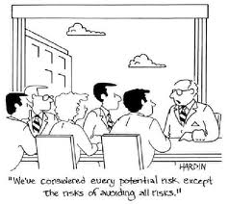
Risk Mitigation Strategy
What do we have to do to lessen the risk?
It’s pretty simple. Undertake a Risk Mitigation Strategy.

Slide 6
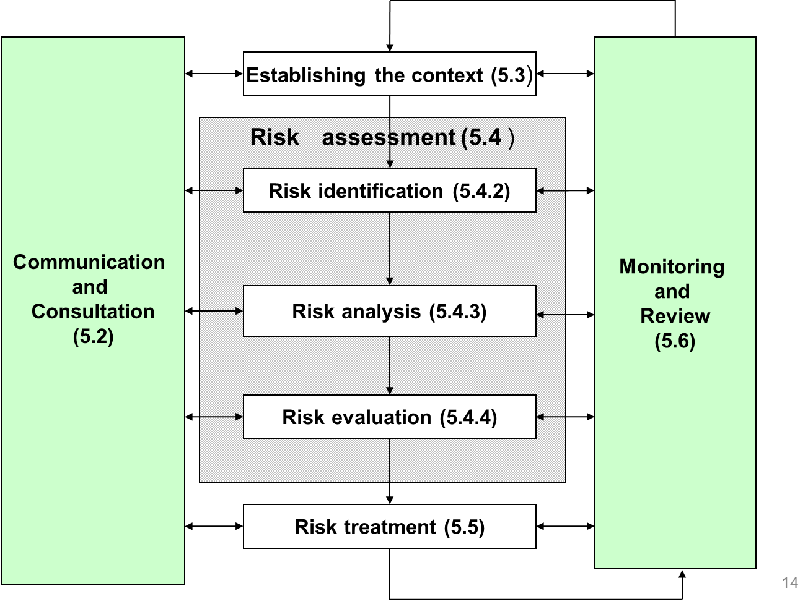
What is a Risk Mitigation Strategy?
This is how you assess your risks and work out if they are low risk (green), moderate risk (yellow or caution) or extreme risk (red or alert), then what action is required and what to do if the risk escalates. Simples!
The Risk Analysis process was outlined as follows:
Establish the context of the Risk
Identify the Risk
Analyse the Risk
Evaluate the Risk
Strategies to address the Risk, ie., mitigate and/or eliminate the Risk
Monitor and Review the Risk
Communicate the Risk on a continual basis throughout the process
Chisholm – 9 Main Risk Analysis Lecture 4, F. M.Hemmings
Notes:
OH HELL YOU SAY! WHAT’S THAT? NOT AS BAD AS IT LOOKS.
IDENTIFY THE RISK, IE., JOYSTICKS AND CONTROL LEVERS HANDLED BY VARIOUS PEOPLE, GETTING IN AND OUT OF GLIDERS AND WHERE HANDS ARE PLACED, DOING UP PARACHUTES, HANDLING TOW OUT DOLLIES AND OTHER GEAR, DRIVING TRACTORS AND OR OTHER PEOPLE’S CARS TO PICK UP GLIDERS ON THE AIRFIELD, USING THE SAME PEN IN THE COCKPIT, USING THE SAME AIRFIELD PHONE, USING THE SAME AIRFIELD COMPUTER…….AND THE LIST GOES ON.
ANALYSE THE RISK, IE., IS THIS A PROBLEM? COULD IT BECOME A PROBLEM? IS IT LOW RISK, MODERATE RISK OR EXTREME RISK?
EVALUATE THE RISK, IE., SHOULD WE UNDERTAKE THIS ACTIVITY NOW? WILL THIS CAUSE INFECTION? ARE WE REALLY READY?
STRATEGIES TO MITIGATE AND/OR ELIMINATE THE RISK
MONITOR AND REVIEW AFTER EVERY ACTIVITY, IE., WHAT WENT WELL, WHAT DID NOT GO WELL, WHAT CAN WE DO BETTER
COMMUNICATE, COMMUNICATE, COMMUNICATE CONTINUALLY THROUGH THE PROCESS

Slide 7
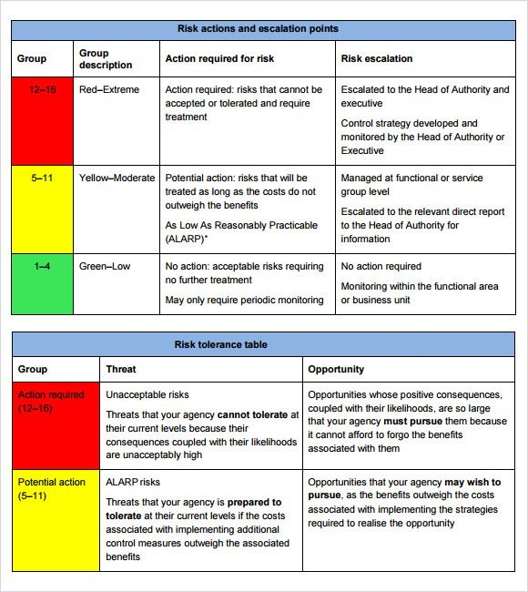
Risk mitigation chart
Notes:
SIMPLES!!
A SIMPLE CODED CHART TO IDENTIFY EXTREME, MODERATE AND LOW RISK.
RED - WHAT DO YOU NEED TO ACTION IMMEDIATELY THAT IS A REAL PROBLM,
YELLOW - A.L.A.R.P. “AS LOW AS REASONABLY PRACTICABLE” RISKS THAT YOU CAN MANAGE AND TREAT AS LONG AS THE COSTS DON’T OUTWEIGH THE BENEFITS. THIS COULD BE QUANTITIES OF HYGIENIC MATERIALS THAT MAY OUTWEIGH THE COST OF PROVIDING THE FLIGHT, OR PRESSURING A 65 YO L2 INSTRUCTUR TO TAKE PASSENGERS BECAUSE THEY ARE THE ONLY ONES AVAILABLE.
GREEN – ACCEPTABLE RISK, NO FURTHER ACTION REQUIRED. BUT STILL MONITOR AND REVIEW JUST IN CASE.
THE TOLERANCE TABLE IS TO IDENTIFY THE UNACCEPTABLE RISKS BUT IT’S ALSO AN OPPORTUNITY TO REVIEW YOUR PRACTICES BECAUSE YOU NEED TO UNDERTAKE THIS ACTIVITY TO MAKE MONEY TO SURVIVE. THE THREATS TO YOUR OPERATION CAN ALSO BE AN OPPORTUNITY FOR YOUR OPERATION/CLUB.

Slide 8
Be prepared……….
So what does that mean?
1.5 metre rule – what will you do? Will you be able to take passengers? Will you want to?
All instructors and officials have the government COVID9 App installed on their mobile phones.
Are you ready with a 10 litre container of hand sanitizer, hand wipes and cleaning products?
Have you got a quantity of masks and disposable gloves? Will you need to wear them? Will this be a requirement for instructors, AEIs and passengers to stop community transmission?
Have you got a cleaning regime in place in between training and pax flights?
What will be your cleaning regime for gliders and hangars at the end of the day, including parachutes?
What will be your cleaning regime in relation to toilets, both off field and on field and club rooms? Once a day, twice a day? More?
A Risk Mitigation Strategy may well serve all members well as your new members and public AEFs will be looking for health and hygiene measures to be displayed at your site.
Notes:
COVID APP – SOMEONE MAY BE ASYMPTOMATIC SO YOU WILL BE CONTACTED.
MITRE 10, BUNNINGS, COLES, WOOLWORTHS – CONTAINERS OF HAND SANITIZER AND TROLLEY WIPES.
WILL YOU ASK YOUR PASSENGERS TO SUPPLY THEIR OWN CLEANING PARAPHENALIA WHICH IS DEPENDENT ON THE FLIGHT TAKING PLACE? WILL YOU ASK THEIR STATE OF HEALTH? HAVE YOU GOT A STATEMENT ON YOUR WEBSITE OR CLUB INFORMATION, NOT TO TURN UP IF YOU ARE SICK OR FEELING UNWELL?
PEOPLE WILL WANT TO KNOW THE 2 SEAT AIRCRAFT HAS BEEN SANITISED. THEY MAY NOT ASK OR THEY MAY, BUT THEY WILL BE LOOKING.
GLIDERS NO LONGER CLEANED JUST ON THE OUTSIDE, BUT ON THE INSIDE AS WELL. WON’T BE GOING HOME EARLY FROM THE AIRFIELD TODAY!
IS YOUR CLUBHOUSE CLEAN ENOUGH FOR YOU AND THE PUBLIC? ARE YOUR TOILETS CLEAN ENOUGH FOR YOU AND THE PUBLIC? WILL YOU BRING YOUR OWN MUG? WILL YOU PROVIDE DISPOSABLE CUPS FOR WATER OR ASK YOUR PASSSENGERS TO ENSURE THEY HAVE THEIR OWN SUPPLY? YOU NEED TO LOOK AT YOUR OPERATION AND ASSESS THE RISKS.

Slide 9
Think of your members
Think of your POTENTIAL members
Think of your PASSENGERS
Think of THE PUBLIC
Think of YOUR COMMUNITY
START TO PLAN…..NOW

